Slide 1
Towards An Open Data Set for Trace-Oriented Monitoring
Jingwen Zhou¹, Zhenbang Chen¹, Ji Wang¹,
Zibin Zheng², and Michael R. Lyu^{1,2}
¹National University of Defense Technology, Changsha, China
²Chinese University of Hong Kong, Hong Kong, China
Email: {jwzhou, zbchen}@nudt.edu.cn
This work is supported by :
National 973 Program of China (No. 2011CB302603)
NSFC (No. 61161160565 and No. 61303064)
SRFDP (No. 20114307120015)

Slide 2
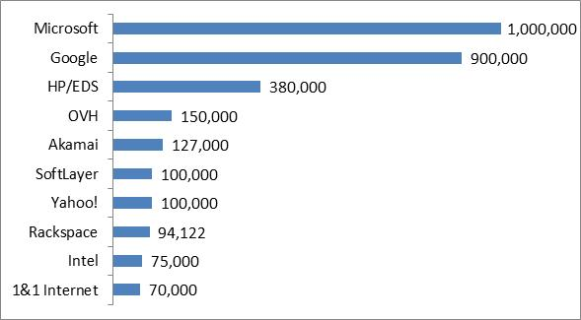
Motivation
…
…
Benefiting our daily life
Supporting different fields
The cloud system becomes more and more popular
2013.7
Increasing in scale
Increasing in complexity

Slide 3
Motivation
…
…
Benefiting our daily life
Supporting different fields
problems happen more and more often in cloud systems
The cloud system becomes more and more popular
2013.7
Increasing in scale
Increasing in complexity

Slide 4
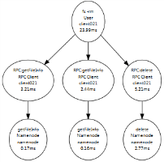
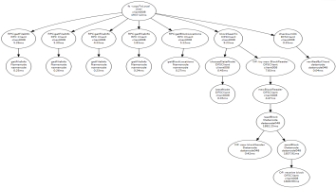
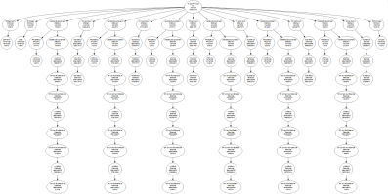
Motivation
In August 2013, meltdowns successively
happened in:
Company | Loss
Amazon | Lost 7 million dollars in 100 minutes.
Google | Lost 550,000 dollars in less than 5 minutes, and the global internet traffic dropped 40%.
…
problems happen more and more often in cloud systems
and bring enormous loss
Detection
Diagnosis
Remediation
Trace-oriented monitoring is one of the methods to improve system reliability at runtime.

Slide 5
Diagnosis
Detection
Remediation
Trace-based research
Detection
Diagnosis
Remediation
There is limited free available trace data set existing.

Slide 6
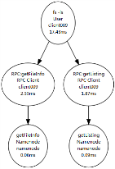
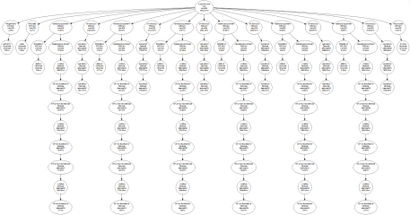
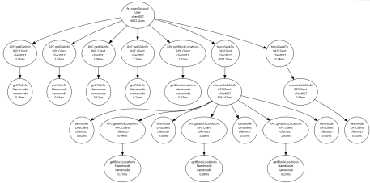
Diagnosis
Detection
Remediation
Trace-based research
We are collecting a trace data set.
…
Choosing or
implementing
a tracing system
Instrumenting
and deploying
a target system
Collecting traces
There is limited free available trace data set existing.

Slide 7
Diagnosis
Detection
Remediation
Trace-based research
Each element in our data set is a trace.
The trace records the execution path of a user request.
Trace = events + relationships
Event: function name and latency …
Relationship: local and remote function calls …
Trace → Trace Tree
Nodes and edges correspond to events and relationships, respectively.
Sample: A trace tree about a read file request in HDFS.
We are collecting a trace data set.
…
Choosing or
implementing
a tracing system
Instrumenting
and deploying
a target system
Collecting traces
There is limited free available trace data set existing.

Slide 8
Structure of Data Set
Class
Type
Trace File
Normal
Workload
collected under different workload speeds
considering different requests, etc.
collected when HDFS running normally
Datanode
collected with various cluster sizes
Process
affect the processes on HDFS nodes
considering different requests, number of faulty nodes, etc.
Abnormal
Network
bring anarchies to the network in the cluster
collected when a fault injected
Data
introduce errors in the data on datanodes
System
inject faults to OSs of the HDFS nodes
Combination
Single
faults are chosen from a single fault type
repeat many times
collected when faults are randomly injected and later eliminated
All
faults are chosen from all the four types

Slide 9
Details in Collection
client001
client002
…
clientN
Clients
control
track
HDFS requests
monitor
monitor
controller
control
MTracer Server
monitor
Ganglia Server
control
control
inject faults
track
monitor
Datanode001
Datanode002
…
DatanodeM
Namenode
HDFS
CloudStack

Slide 10
Details in Collection
start MTracer
and HDFS
stop MTracer
and HDFS
Normal
start Clients
trace collection period
stop Clients
request handling period
inject
a fault
recover
the system
Abnormal
request handling period
inject
a fault
inject
a fault
inject
a fault
inject
a fault
inject
a fault
Combination
request handling period

Slide 11
Threads to Invalidity
Traces are collected only on HDFS.
Traces from HDFS are representative, because:
HDFS is a widely used system,
and many mechanisms and procedures in HDFS are shared by others.
During collection, the maximal DN number is 50.
It is enough for exhibiting various features of HDFS, because:
traces are collected in different scenarios.
Many other faults exist rather than the injected faults.
Injected faults are representative, because:
containing different types,
involving both function and performance faults,
and selecting the most frequent faults.

Slide 12
Thank for your attention!
Jingwen Zhou, Zhenbang Chen, Ji Wang,
Zibin Zheng, and Michael R. Lyu
Email: {jwzhou, zbchen}@nudt.edu.cn
This work is supported by :
National 973 Program of China (No. 2011CB302603)
NSFC (No. 61161160565 and No. 61303064)
SRFDP (No. 20114307120015)

