Slide 1
TraceBench: An Open Data Set for Trace-Oriented Monitoring
Jingwen Zhou¹, Zhenbang Chen¹, Ji Wang¹, Zibin Zheng², and Michael R. Lyu^{1,2}
¹PDL, National University of Defense Technology, Changsha, China
²Shenzhen Research Institute, CUHK, Shenzhen, China
{jwzhou, zbchen}@nudt.edu.cn
18 December 2014
http://mtracer.github.io/TraceBench/

Slide 2
Motivation

Slide 3
Cloud System
The cloud system becomes more and more popular
…
…
Benefiting our daily life
Supporting different fields

Slide 4
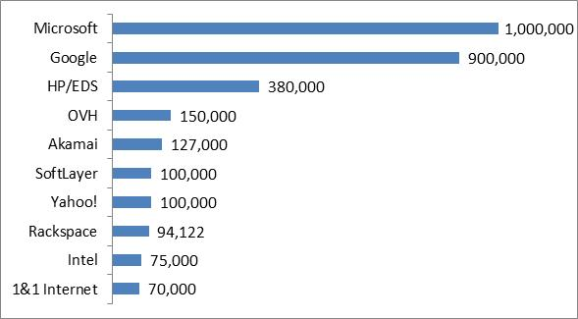
Cloud System
problems happen more and more often in cloud systems
The cloud system becomes more and more popular
…
…
Benefiting our daily life
Supporting different fields
2013.7
Increasing in scale
Increasing in complexity
In August 2013, meltdowns successively
happened in:
Company | Loss
Amazon | Lost 7 million dollars in 100 minutes.
Google | Lost 550,000 dollars in less than 5 minutes, and the global internet traffic dropped 40%.
…

Slide 5
System Monitoring
System monitoring is an important method to improve the reliability of cloud systems at runtime.
In our category, system monitoring includes the activities of:
Supervising
Analyzing
Adjusting
such as the topics of tracing, failure detection, fault diagnosis, system recovery …

Slide 6
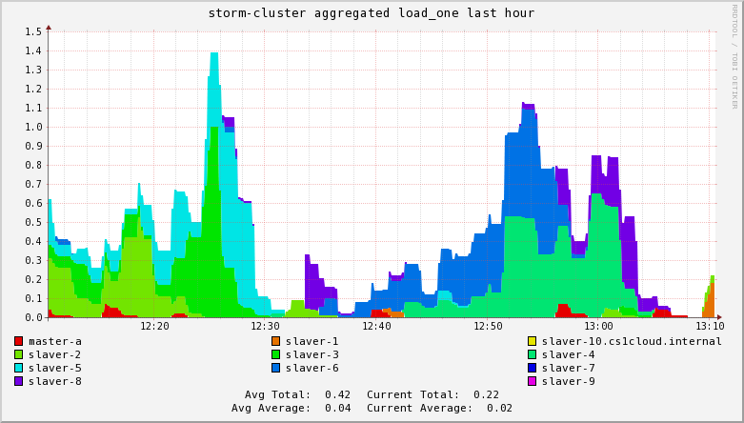
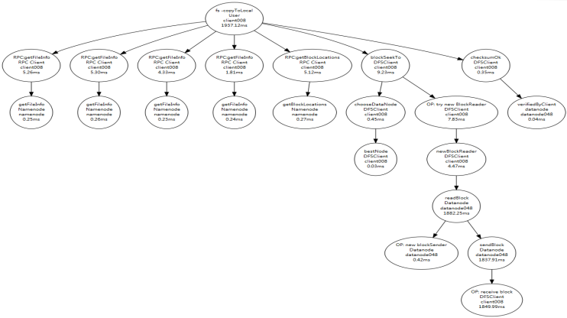
System Monitoring
Based on the recorded/used data, monitoring systems can be divided into:
Resource-oriented Monitoring
Trace-oriented Monitoring
later
Record/use the resource metrics, such as CPU and memory
Ganglia, Chukwa …
Record/use the paths of system execution, or called the traces
X-Trace, Dapper, Zipkin …
Generally speaking, the trace provides more valuable information than the resource metrics in revealing system behaviors.
Currently, more and more attentions are paid to the trace-oriented monitoring, which effectively improves the reliability of cloud systems.

Slide 7
Motivation
The trace data is essential for the trace-oriented monitoring topics, e.g., evaluating the designed algorithms.
However, there are some difficulties in getting the data of trace:
1. Collecting traces by hand is a tedious and time-consuming process.
…
Choosing or
implementing
a tracing system
Instrumenting
and deploying
a target system
Designing and collecting traces
2. Manually synthesized traces are weak in authenticity and usability.
3. There is few data set of trace existing in academia
and industry.
4. Companies do not want to release their traces which
record the internal details of their systems.

Slide 8
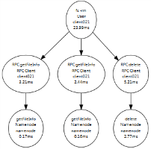
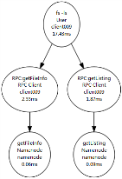
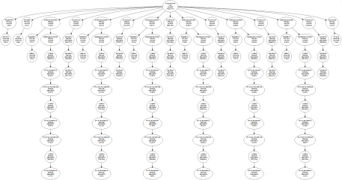
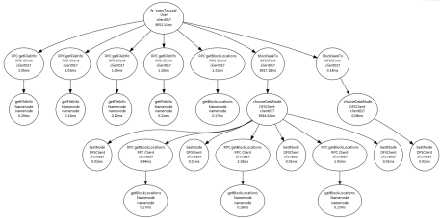
Motivation
Supervising
Analyzing
Adjusting
Trace-oriented monitoring topics
1. Data Format
2. Other Details
3. Applications
4. Discusses
TraceBench

Slide 9
Data Format

Slide 10
Trace
The trace records the process of system running,
and can be expressed as:
low
less
Linear event sequence
TraceBench stores the traces in the form of trace tree.
Trace tree
high
more
Request flow graph
complexity
information

Slide 11
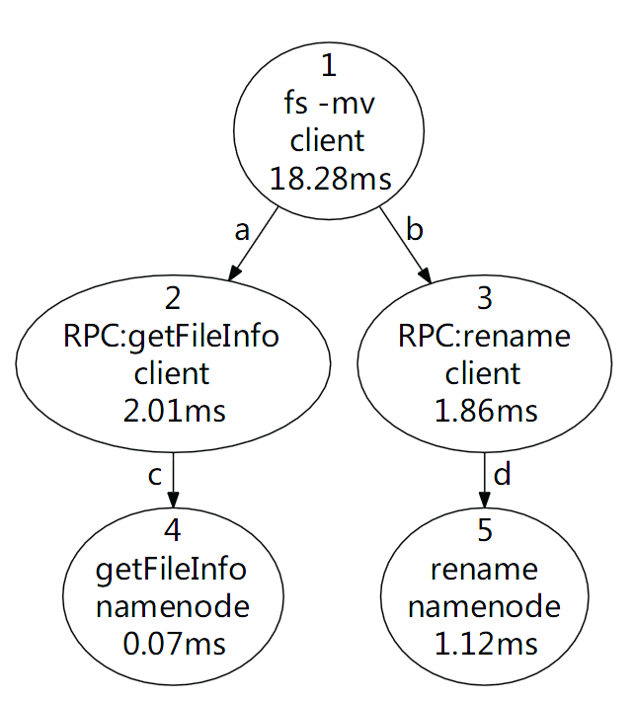
Trace Tree

Slide 12
Trace Tree
Trace = events + relationships
Event: function name and latency …
Relationship: local and remote function calls …
Trace => Trace Tree
Nodes correspond to events.
Edges correspond to relationships
Trace Tree => linear event sequence
events
relationships
1
id: 1
name: fs -mv
……
a
fatherId: 1
childId: 2
type: local call
……
2
id: 2
name: RPC:getFileInfo
……
……
……
DFS: 1 , 2, 4, 3, 5

Slide 13
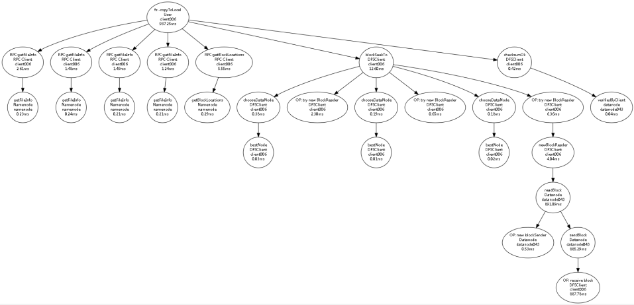
Samples
Normal
Meet a killDN fault (function fault)

Slide 14
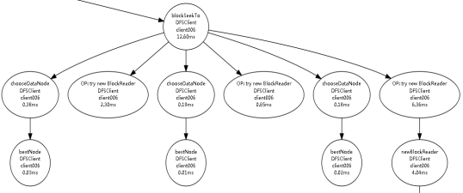
Samples
Normal
Meet a killDN fault (function fault)

Slide 15
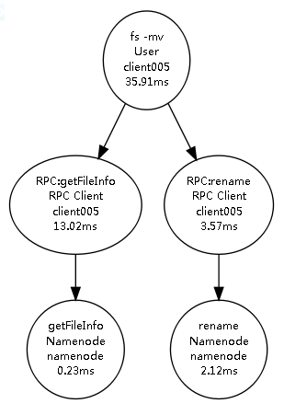
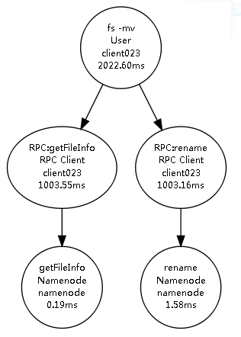
Samples
Meet a slowHDFS fault
(Performance fault)
Normal

Slide 16
Other Details

Slide 17
Structure
Class
Type
Trace File
Normal
Workload
collected under different workload speeds
Collected when system
running normally
Datanode
collected with various cluster sizes
Each trace file corresponds to a certain scenario, considering different cluster size, request type,
workloads speed, injected faults, etc.
Process
affect the processes on HDFS nodes
Abnormal
Network
bring anarchies to the network in the cluster
Collected when a
permanent fault injected
Data
introduce errors in the data on datanodes
System
inject faults to OSs of the HDFS nodes
Combination
Single
faults are chosen from a single fault type
Collected when system
encountering temporal faults
All
faults are chosen from all the four types

Slide 18
Statistics
The whole collection work lasted for more than half a year.
50 clients + (50+1) HDFS nodes + others > 100 hosts
inject 14 faults of 4 types
whole size of TraceBench ≈ 3.2 GB, including:
361 trace files
366,487 traces
14,724,959 events
6,273,497 relationships
trace length = [5, 420]
nodes per trace = [2, 44]
……

Slide 19
Collection Process
client001
client002
…
clientN
Clients
control
track
HDFS requests
monitor
monitor
controller
control
MTracer Server
monitor
Ganglia Server
control
control
inject faults
track
monitor
Datanode001
Datanode002
…
DatanodeM
Namenode
HDFS
CloudStack

Slide 20
Collection Process
start MTracer
and HDFS
stop MTracer
and HDFS
Normal
start Clients
trace collection period
stop Clients
request handling period
inject
a fault
recover
the system
Abnormal
request handling period
inject
a fault
inject
a fault
inject
a fault
inject
a fault
inject
a fault
Combination
request handling period

Slide 21
Applications

Slide 22
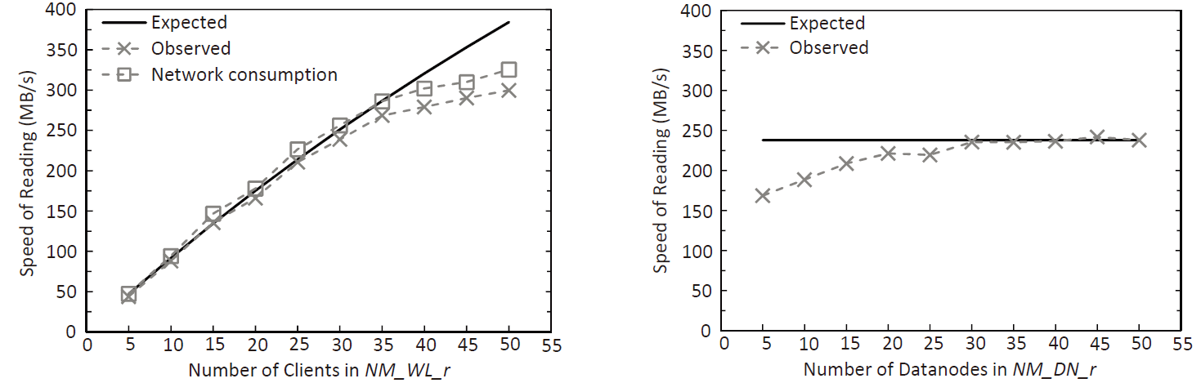
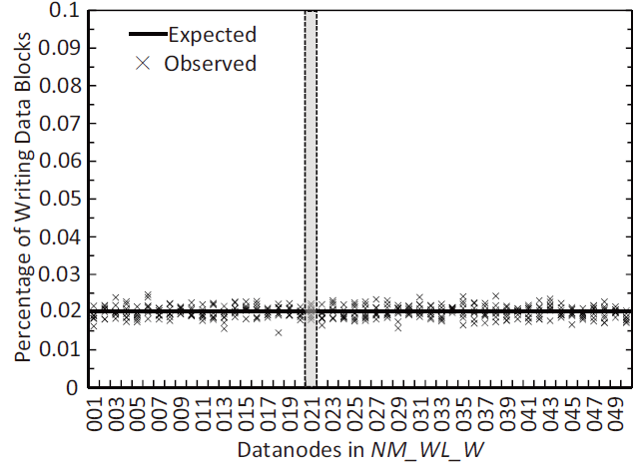
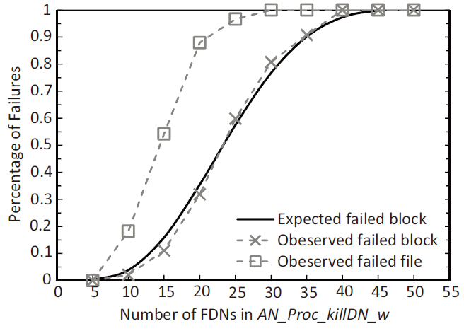
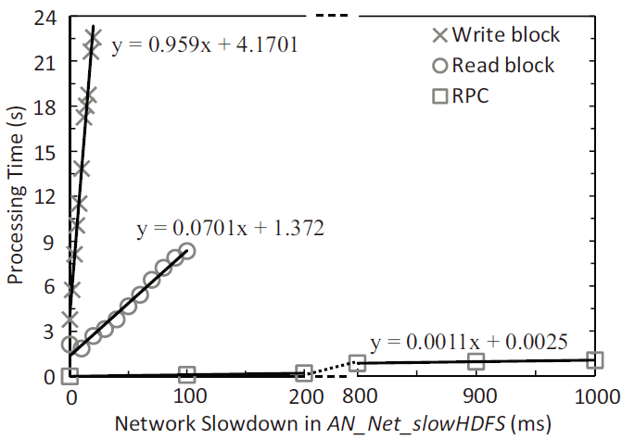
Data Analysis
Based on TraceBench, we analyzed the behaviors of HDFS on the aspects of request handling, workload balancing, fault influence, etc.

Slide 23
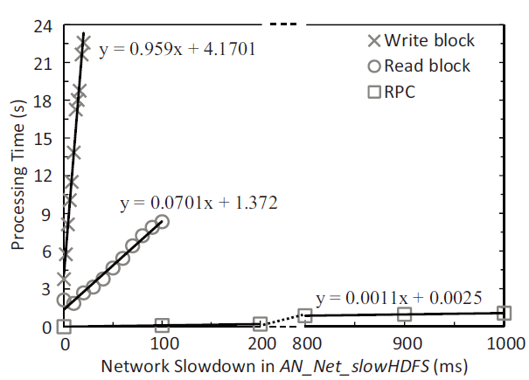
Data Analysis
Based on TraceBench, we analyzed the behaviors of HDFS on the aspects of request handling, workload balancing, fault influence, etc.
Analysis of the influence of a performance fault

Slide 24
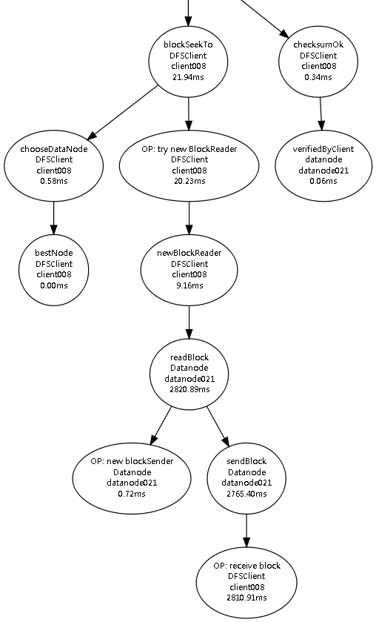
Detecting Failed Requests
The same kind of user requests usually result in the traces with similar topologies, which can be extracted as properties.
For example:
Reading a data block starts with invoking:
blockSeekTo (B)
if success, ends with:
checksumOK (K)
So, a successful file read request should satisfy the following LTL property:
Exist
Always
Next
Read at least one data block
The last data block reading
Successfully reading
If a trace of read request violates the property, we say a failure happens.

Slide 25
Detecting Failed Requests
Similarly, we extracted properties for other requests:
In the form of SQL queries, we check the traces with above properties in some TraceBench sets with faults injected in.
100% of failed traces are identified without FPs.
Besides detecting failures, we also extracted properties for detecting faults in requests, e.g., read request:

Slide 26
Mining Temporal Invariants
Synoptic*: a tool for mining temporal invariants from logs.
With Synoptic, we mined temporal invariants in TraceBench:
Always followed by
Never followed by
Totally ordered
From TraceBench
Always precedes of
partially ordered
*https://code.google.com/p/synoptic/

Slide 27
Mining Temporal Invariants
When dealing PO logs:
1. Too many invariants are generated.
2. Some false invariants arise.
3. many invariants contain the same information.
Reason: Synoptic treats the same kind of events generated from different hosts as different events.
Conclusion: When dealing PO logs, Synoptic seems to be more suitable for the systems with few hosts.

Slide 28
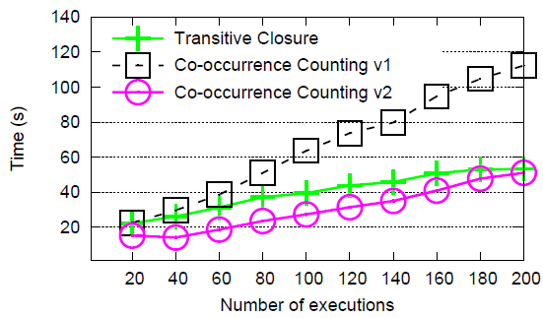
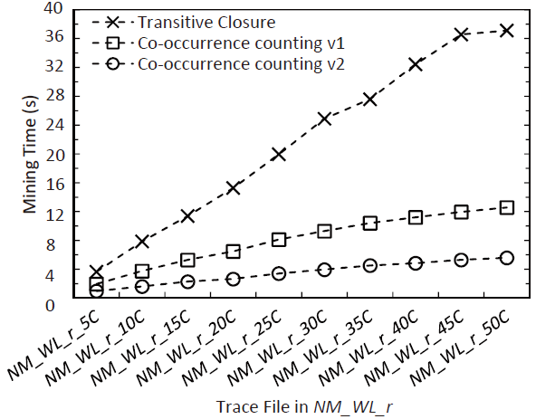
Mining Temporal Invariants
Synoptic on synthesized logs vs. on TraceBench
with synthesized logs [1]
with TraceBench
The experiment results based on TraceBench are more convincing.
[1] I. Beschastnikh, Y. Brun, M. D. Ernst, A. Krishnamurthy, and T. E. Anderson, “Mining temporal invariants from partially ordered logs,” ACM SIGOPS Operating Systems Review, 45(3), pp. 39–46, 2011.

Slide 29
Diagnosing Performance Anomalies
We implemented a PCA based performance anomalies diagnosing algorithm[2] and evaluated it with TraceBench.
(total anomalies),(found anomalies),(incorrectly found anomalies)
[2] A. Lakhina, M. Crovella, and C. Diot, “Diagnosing networkwide traffic anomalies,” in Proceedings of SIGCOMM 2004, pp. 219–230, 2004.

Slide 30
Diagnosing Performance Anomalies
1. Find all anomalies in some cases
2. However sometimes only a small parts
3. Without false alarm in our experiments
4. Analysis time increases very fast with the trace length
5. but slowly when growing the trace amount
This algorithm is sensitive with the feature of data
This algorithm is pretty accurate
This algorithm is more feasible for short traces

Slide 31
Discusses

Slide 32
Discusses
Traces are collected only on HDFS.
Traces from HDFS are representative, because:
HDFS is a widely used system,
and many mechanisms and procedures in HDFS are shared by others.
During collection, the HDFS cluster is small.
It is enough for exhibiting various features of HDFS, because:
traces are collected in different scenarios.
Many other faults exist rather than the injected faults.
Injected faults are representative, because:
containing different types,
involving both function and performance faults,
and selecting the most frequent faults.

Slide 33
Thanks and Any Questions?
http://mtracer.github.io/TraceBench/

