Slide 1
A Runtime Verification Based Trace-Oriented Monitoring Framework for Cloud Systems
Jingwen Zhou¹, Zhenbang Chen¹, Ji Wang¹, Zibin Zheng² , and Wei Dong¹
Email: {jwzhou, zbchen}@nudt.edu.cn
¹PDL & College of Computer, NUDT, Changsha, China
²Shenzhen Research Institute, CUHK, Shenzhen, China

Slide 2
Motivation

Slide 4
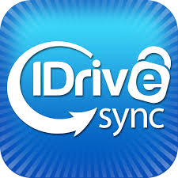
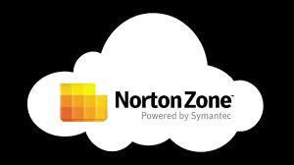
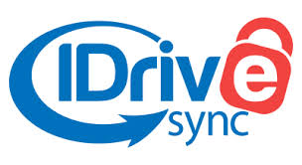

Slide 5
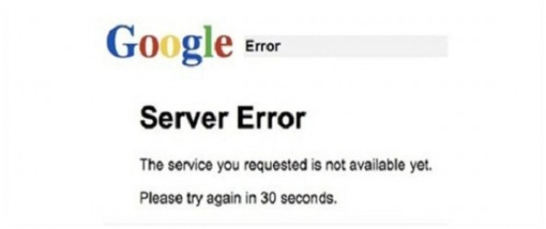
June 17, 2008
Google AppEngine partial outage due to programming error
last 5 hours
August 11, 2008
Gmail site unavailable due to outage in contacts system
last 1.5 hours
January 31, 2009
Google search outage due to programming error
last 40 min
March 13-14, 2008
Malfunction in Windows Azure
last 22 hours
…
August, 2013
meltdowns
Amazon: $7,000,000/100min
Google: $550,000/5min
......
February 24, 2009
Gmail and Google Apps Engine outage
last 2.5 hours
July 20, 2008
S3 outage: single bit error leading to gossip protocol blowup
last >6 hours
June 29, 2010
intermittent performance problems
last 3 hours
February 15, 2008
S3 outage: the authentication service overload leading to unavailability
last 2 hours

Slide 6
June 17, 2008
Google AppEngine partial outage due to programming error
last 5 hours
August 11, 2008
Gmail site unavailable due to outage in contacts system
last 1.5 hours
January 31, 2009
Google search outage due to programming error
last 40 min
March 13-14, 2008
Malfunction in Windows Azure
last 22 hours
…
August, 2013
meltdowns
Amazon: $7,000,000/100min
Google: $550,000/5min
......
February 24, 2009
Gmail and Google Apps Engine outage
last 2.5 hours
July 20, 2008
S3 outage: single bit error leading to gossip protocol blowup
last >6 hours
June 29, 2010
intermittent performance problems
last 3 hours
February 15, 2008
S3 outage: the authentication service overload leading to unavailability
last 2 hours

Slide 7
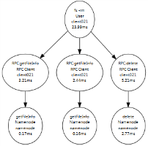
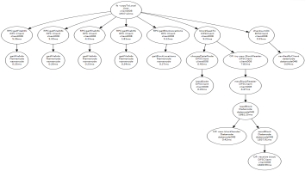
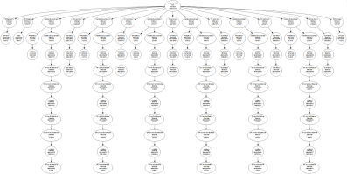
Detection
Diagnosis
Fixing
…
User request trace-oriented monitoring is an important method to improve system reliability at runtime.

Slide 8
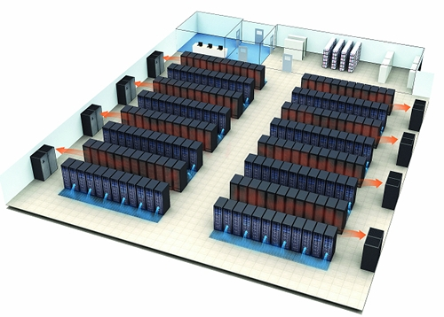
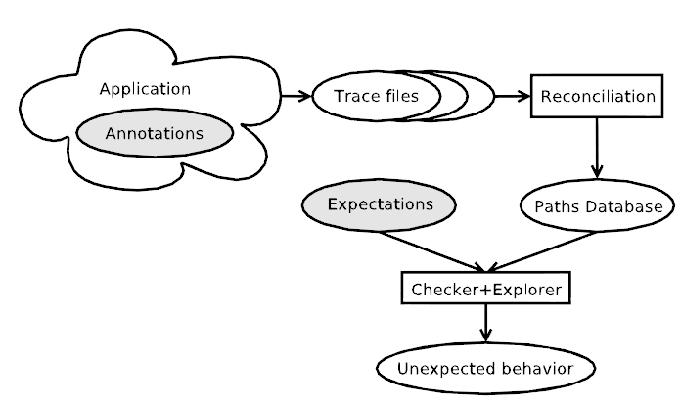
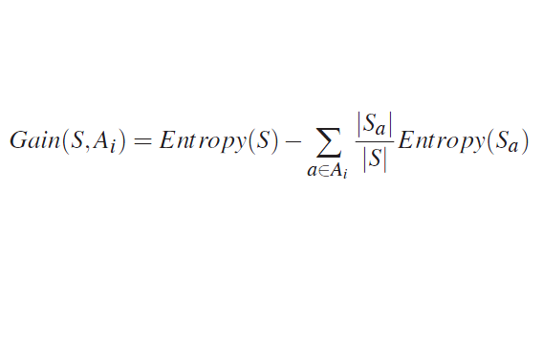
Currently, many trace-oriented monitoring frameworks exist, such as Dapper, Zipkin, X-ray, P-Tracer, MTracer, …
However, two aspects need further investigations:
1. The method for specifying monitoring requirements.
Monitoring Requirements
Developers or
Administrators
Pip
IRONModel

Slide 9
Currently, many trace-oriented monitoring frameworks exist, such as Dapper, Zipkin, X-ray, P-Tracer, MTracer, …
However, two aspects need further investigations:
1. The method for specifying monitoring requirements.
2. The efficiency of monitoring.
1 sec
T
Request_1
…
Request_100
…
Request_1000
…
Huge
trace
data
Handled in a complex process. For example, a simple Google search request will trigger more than 200 sub-requests and cross hundreds of servers.
vs
Real-time
A problem faced by all existing methods!

Slide 10
Currently, many trace-oriented monitoring frameworks exist, such as Dapper, Zipkin, X-ray, P-Tracer, MTracer, …
However, two aspects need further investigations:
1. The method for specifying monitoring requirements.
2. The efficiency of monitoring.
To facilitate these issues, we bring runtime verification (RV) into the field of the trace-oriented monitoring for cloud systems.
Runtime Verification
Expressive specification languages
Automatic monitor generation
Efficient monitoring

Slide 11
Framework

Slide 12
properties
PDB
Monitor Generator
results
Preprocess
Monitors
traces
Tracing System
trace data collecting
A Cloud System

Slide 13
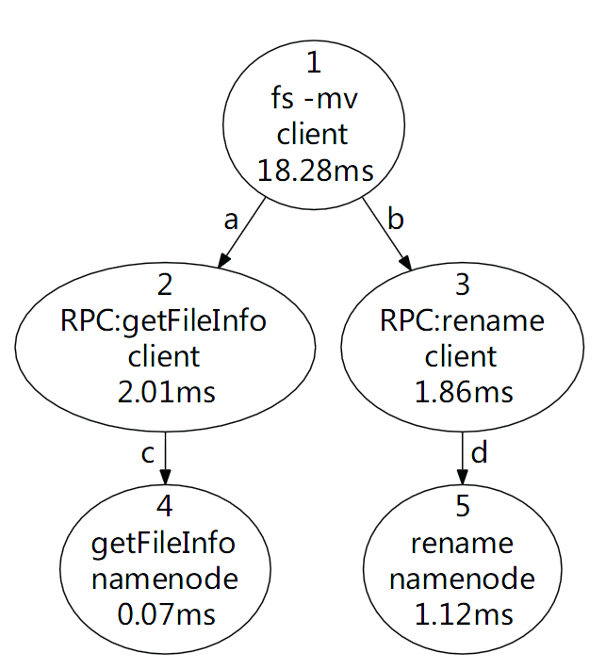
The trace records the execution path of a user request.
Trace = events + relationships
Event: function name and latency …
Relationship: local and remote function calls …
Trace → Trace Tree
Nodes correspond to events.
Edges correspond to relationships, e.g., a and c.
Trace Tree → linear event sequence
DFS: 1,2,4,3,5
Call and Return: C1C2C4R4R2C3C5R5R3R1
Compared with the resource-oriented methods, traces can record more find-grained information, e.g., RPC and execution time.

Slide 14
Preliminary Evaluation

Slide 15
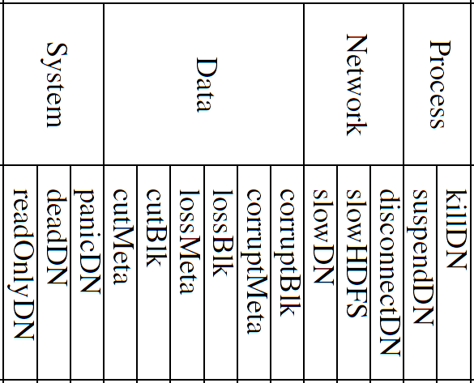
We collected a trace data set (TraceBench) in an HDFS deployed on a real environment,
Considering different kinds of user requests
write: uploading files to HDFS
read: downloading files from HDFS
rpc: file management, like querying, removing, renaming, …
Injecting various faults
With various cluster size, request speed, etc.
http://mtracer.github.io/TraceBench/

Slide 16
Based on TraceBench, we extract many such properties and we can correctly and flexibly expressing them all! Following are some samples.
Each read request contains at least one reading operation.
And the last reading operation
should be successful.
Or else, we say it is a failed read request.

Slide 17
In the form of SQL queries, we check the traces with above properties in all sets with faults injected in.
100% of failed traces are identified without FPs.
Several failed traces are also found in the Normal set, with the reason of losing events in the tracing system.

Slide 18
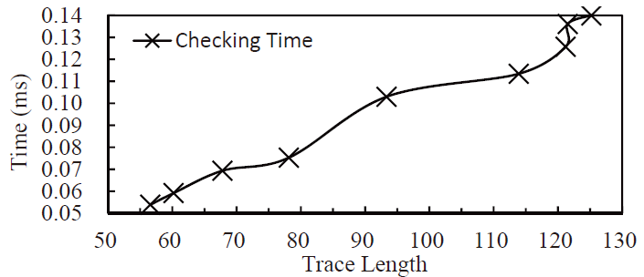
Checking traces in killDN set using Property 2 with a notebook of 4×2.5 GHz CPU and 4 GB memory.
About 10,000 traces can be checked in 1 second in this condition, which is a promising result.
In addition, the efficiency can be further improved with various optimizations.

Slide 19
Future work

Slide 20
Integrating existing RV frameworks into our tracing system
Highly efficient and scalable monitoring algorithms and effective machine learning methods for properties.
Using RV to monitor the performance aspects
More applications on other real world cloud systems

Slide 21
Framework and Data Set
Tracing Framework available at:
http://mtracer.github.io/MTracer/
Data set available at:
http://mtracer.github.io/TraceBench/
Online demonstration at:
http://www.wsdream.net/mtracer-viz/

Slide 22
Thanks for Your Attention! And Any Questions?

Slide 23
Backup Slides

Slide 24
In the rest, the traces discussed are collected in HDFS, which is a widely used cloud file storage system.
HDFS

Slide 25
rpc
Starts with getFileInfo, to know if file exists.
Followed by some other RPCs, for related operations.
A failure occurs when a violation happens.

Slide 26
read
Consist of many data block reading operations
starting with blockSeekTo (B),
the last one should be correct
indicated by checksumOK (K).
A failure occurs when a violation happens.

Slide 27
write
Similar with read, consists many data block writing operations,
by calling createBlockOutputStream (C) .
and the last one should be correct
indicated by the equality of receiveBlock (R) and wirteBlock (W).
where Oª is the abstract next operator in CaRet.
And a failure occurs when a violation happens.

